Slide 1
Bar Type TFT Display
YEEBO NEW LAUNCH PRODUCT

Slide 2
CONTENTS
1
What is Bar type TFT?
Bar Type TFT Display
2
Application
YEEBO NEW LAUNCH PRODUCT
3
Roadmap - TFT
4
Roadmap – TFT+CTP
5
Introduction

Slide 3
1
What is Bar type TFT?

Slide 4
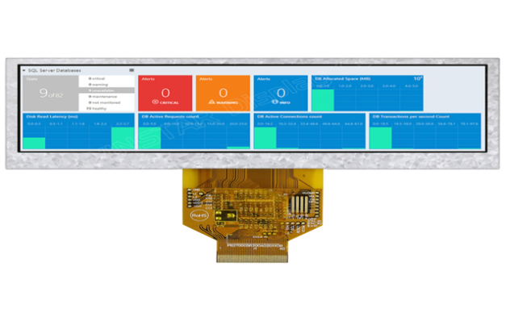
1
What is Bar type TFT?
YB Bar Type TFT
Bar type TFT is Landscape stretched Display.
The mainstream aspect ratio of the TFT LCD panel in the market is 4:3 or 16:9.
But for some applications, bar type shape of display panel would be much better than the current mainstream 4:3 or 16:9 to display the required information.
YEEBO Bar Type TFT-LCD displays are perfect for industrial equipment, automotive application, server system, POS system, dynamic information displays and advertising display.
We offer different sizes Bar Type TFT (Stretched Bar LCD Display) including sizes of 3.9 inch, 4.6 inch and 6.5 inch.

Slide 5
2
Application

Slide 6
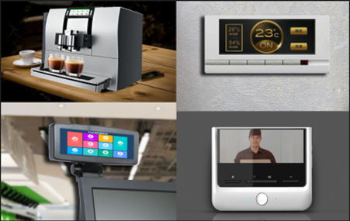
2
Application for Bar Type TFT
YB
YB Bar Type TFT
YEEBO Bar Type TFT-LCD displays are perfect for industrial equipment, automotive application, server system, POS system, dynamic information displays and advertising display.

Slide 7
3
Roadmap-TFT

Slide 8
3
Bar Type TFT Roadmap
Mass Production
6.5”
800RGB*320
Designing
4.6”
800RGB*320
3.9”
480RGB*128
Developing
6.86”
480RGB*1280
2.0”
320RGBx130
2.86”
376RGB*960
2019 Q4
2020 Q1
2020 Q2
Coming soon

Slide 9
4
Roadmap-TFT+CTP

Slide 10
4
Bar Type TFT+CTP Roadmap
Mass Production
Designing
6.5”
800RGB*320
4.6”
800RGB*320
3.9”
480RGB*128
Developing
2020 Q1
2020 Q2
2020 Q3

Slide 11
5
Introduction
(Standard product)

Slide 12
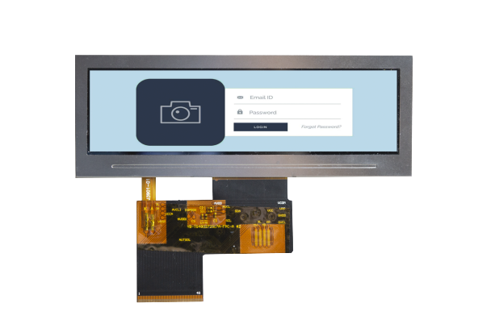
5
Introduction-Standard product
Display Type | IPS （Normally Black）
Display Model | Transmissive
Display Size/Format | 3.9” 480(RGB)*128
Operating Temperature | -20~70℃
Storage Temperature | -30~80℃
Typical Contrast | 800
Viewing Direction | Top Bottom: 80 /80 Left Right: 80 / 80
Backlight Color | White
Applications | Home App / Medical / Instruments
3.9” Bar Type TFT SPEC

Slide 13
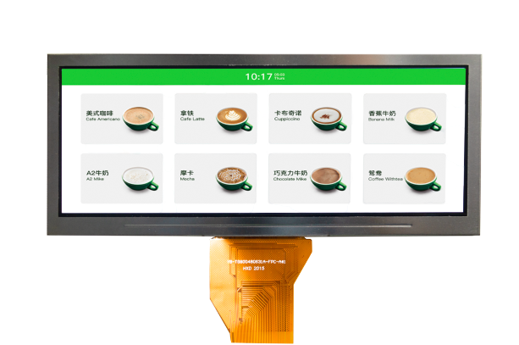
5
Introduction-Standard product
Display Type | TN （Normally White）
Display Model | Transmissive
Display Size/Format | 4.6” 800(RGB)*320
Operating Temperature | -20~70℃
Storage Temperature | -30~80℃
Typical Contrast | 500
Viewing Direction | Top Bottom: 60 /65 Left Right: 70 / 70
Backlight Color | White
Applications | Home App / Medical / Instruments
4.6” Bar Type TFT SPEC

Slide 14
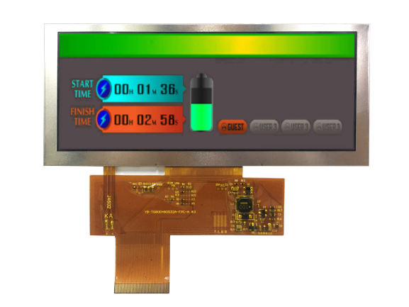
5
Introduction-Standard product
Display Type | TN （Normally White）
Display Model | Transmissive
Display Size/Format | 6.5” 800(RGB)*320
Operating Temperature | -20~70℃
Storage Temperature | -30~80℃
Typical Contrast | 500
Viewing Direction | Top Bottom: 60 /70 Left Right: 70 / 70
Backlight Color | White
Applications | Home App / Medical / Instruments
6.5” Bar Type TFT SPEC

Slide 15
THANKS
BAR TYPE DISPLAY NEW LAUNCH SERIES
YEEBO

